Slide 1


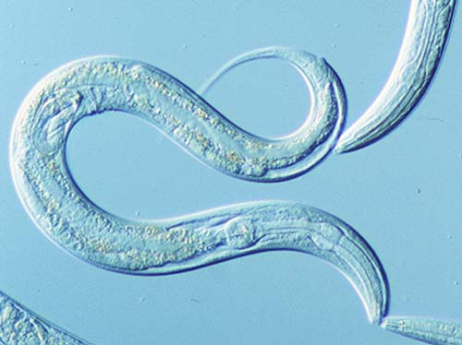
Chapter 9. Pseudocoelomate: Aschelminthes (Lophotrochozoan and Ecdysozoan phyla)
Caenorhadditis elegans

Slide 2
OUTLINE
9.1 General Characteristics
9.2 Phylum Rotifera 轮虫
9.3 Phylum Acanthocephala 棘头
9.4 Phylum Nematoda 线虫
9.5 Phylum Nematomorpha 线形
9.6 Phylum Kinorhyncha 动吻
9.7 Phylum Loricifera 铠甲
9.8 Phylum Priapulida 鳃曳
Lopho-
trochozoa
Ecdysozoa

Slide 3
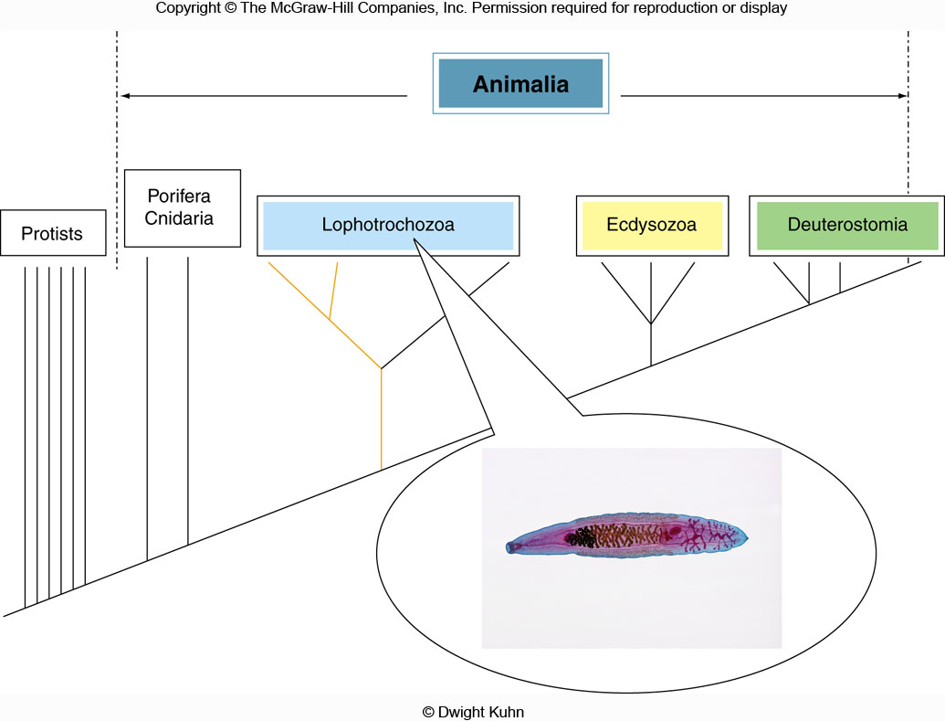
= Metazoa
Protostomia
+
Lophotrochozoa: trochozoans ( Nemertea, Mollusca, Sipuncula, and Annelida)
and lophophorata (Bryozoa, Entoprocta, Phoronida, and Brachiopoda);
Ecdysozoa: Arthropoda (insects, chelicerata, crustaceans, and myriapods), Nematoda;
Deuterostomia: Chordata (vertebrates and their kin), Echinodermata (sea stars, sea urchins,
sea cucumbers,) and Hemichordata (acorn worms).

Slide 4
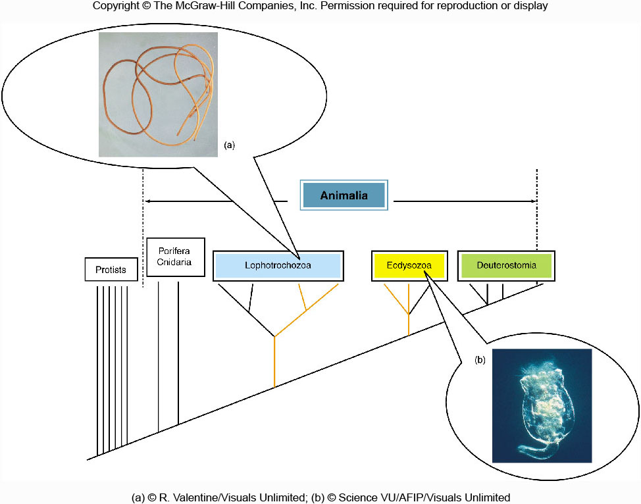
Phylogenetic positions of pseudocoelomates

Slide 5
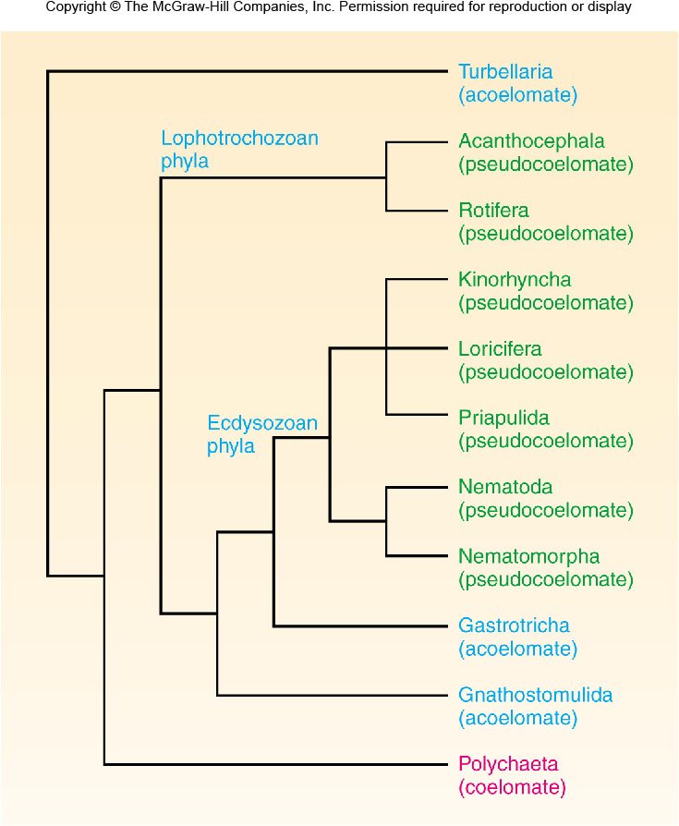
棘头
动吻
铠甲
鳃曳
Cladogram of the
seven
pseudocoelomate
phyla

Slide 6
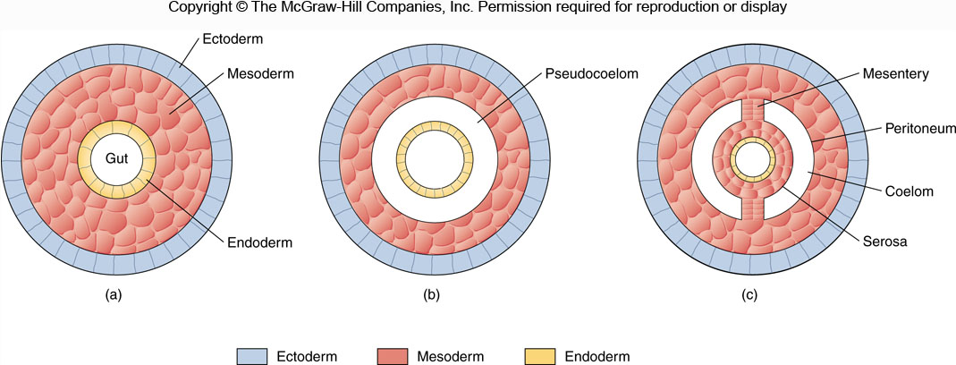
肠系带
体腔膜
浆膜
Triploblastic body plans

Slide 7
OUTLINE
9.1 General Characteristics
9.2 Phylum Rotifera 轮虫
9.3 Phylum Acanthocephala 棘头
9.4 Phylum Nematoda 线虫
9.5 Phylum Nematomorpha 线形
9.6 Phylum Kinorhyncha 动吻
9.7 Phylum Loricifera 铠甲
9.8 Phylum Priapulida 鳃曳
9.9 Phylum Enoprocta 内肛
Lopho-
trochozoa
Ecdysozoa

Slide 8
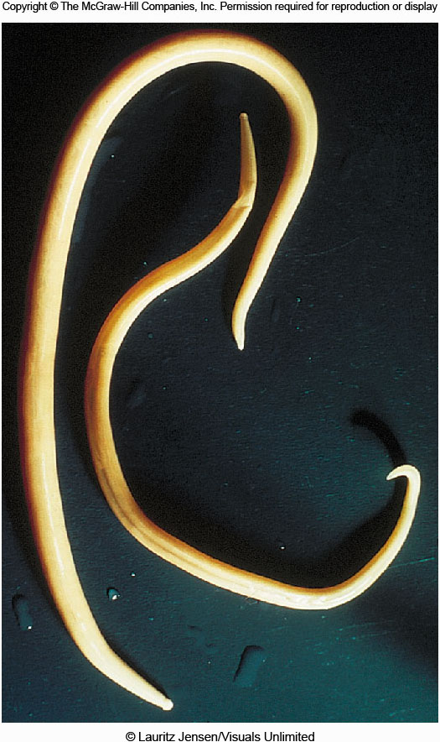
Pseudocoelomates are also called aschelminthes (囊蠕虫) for convenience;
Aschelminthes include seven phyla with great differences, and their phylogeny is controversial, their origins may be polyphyletic;
A pair of roundworms

Slide 9
Common features of pseudocoelomates
The major common feature is a pseudocoelom;
Complete digestive tract, and muscular pharynx (Digestion is processed along a certain direction, promoting differentiation of the digestive tract);
Constant cell numbers (Adult C.elegans, 959);
Protonephridia;
Cilia is absent while a thin, tough, external cuticle角质层
is present;
Mostly dioecious雌雄异体;
Bilateral, unsegmented, triploblastic, and cylindrical圆柱形
in cross section;
Mostly inhabit freshwater, free-living or parasitic lifestyle.

Slide 10
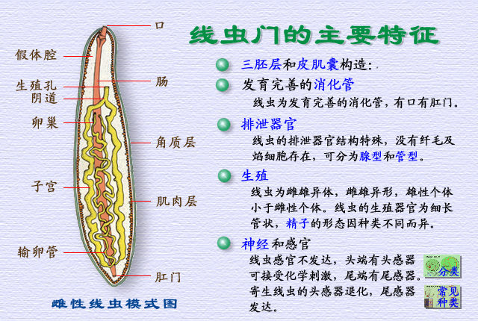
Mouth
Pseudocoelom
Gonopore
Vagina
Intestine
Ovary
How about
male nematode?
Cuticle
Uterus
Muscle process
Oviduct
Anus
A vertical section of a female nematode

Slide 11
What is a pseudocoelom?
No muscular or connective tissues are associated with the gut tract;
No peritoneum体腔膜 and mesentery 肠系膜 suspend organs in the body cavity, so their internal organs lie free in the cavity;
No gastrodermis muscular layer胃层肌肉层, but do have epidermic muscular layer体壁肌肉层;
Pseudocoelomates are the first group of animals that possess a body cavity, although pseudocoelom is primitive.

Slide 12
Evolutionary significance of pesudocoelom
Proving space for the development of internal organs and systems;
Promoting locomotion ability conferred by muscular layers and body-cavity liquid;
Transporting nutritions and metabolic products.

Slide 13
OUTLINE
9.1 General Characteristics
9.2 Phylum Rotifera 轮虫
9.3 Phylum Acanthocephala 棘头
9.4 Phylum Nematoda 线虫
9.5 Phylum Nematomorpha 线形
9.6 Phylum Kinorhyncha 动吻
9.7 Phylum Loricifera 铠甲
9.8 Phylum Priapulida 鳃曳
9.9 Phylum Enoprocta 内肛
Lopho-
trochozoa
Ecdysozoa

Slide 14
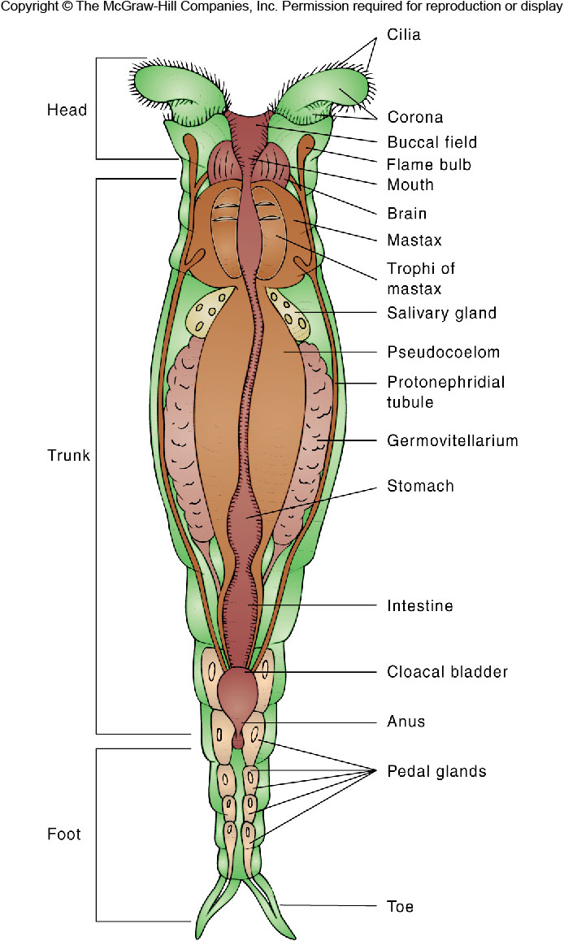
Phylum Rotifera 轮形动物门
About 2000 species
0.1-3 mm long
Ciliated crowns:
locomotion and food gathering
Mastax 咽内咀嚼器: grinding food
Parthenogenesis 孤雌生殖
Most in freshwater, a few marine

Slide 15
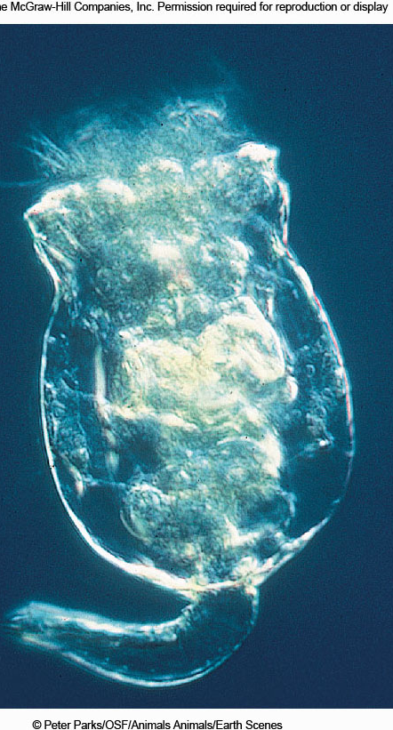
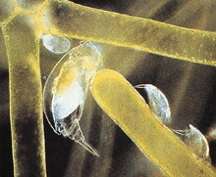
Rotifers feeding on green algae
A rotifera

Slide 16
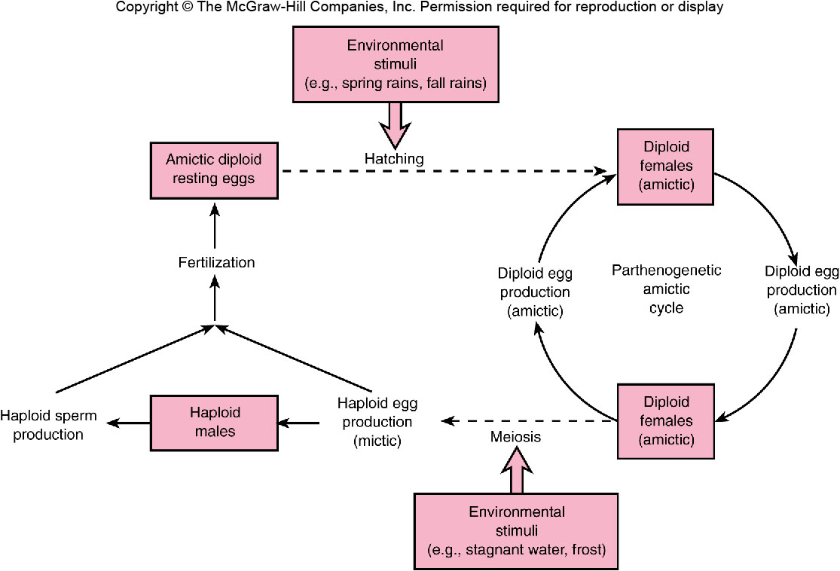
需精卵
Parthenogenesis孤雌生殖 in good conditions
Sexual reproduction in bad conditions

Slide 17
OUTLINE
9.1 General Characteristics
9.2 Phylum Rotifera 轮虫
9.3 Phylum Acanthocephala 棘头
9.4 Phylum Nematoda 线虫
9.5 Phylum Nematomorpha 线形
9.6 Phylum Kinorhyncha 动吻
9.7 Phylum Loricifera 铠甲
9.8 Phylum Priapulida 鳃曳
9.9 Phylum Enoprocta 内肛
Lopho-
trochozoa
Ecdysozoa

Slide 18
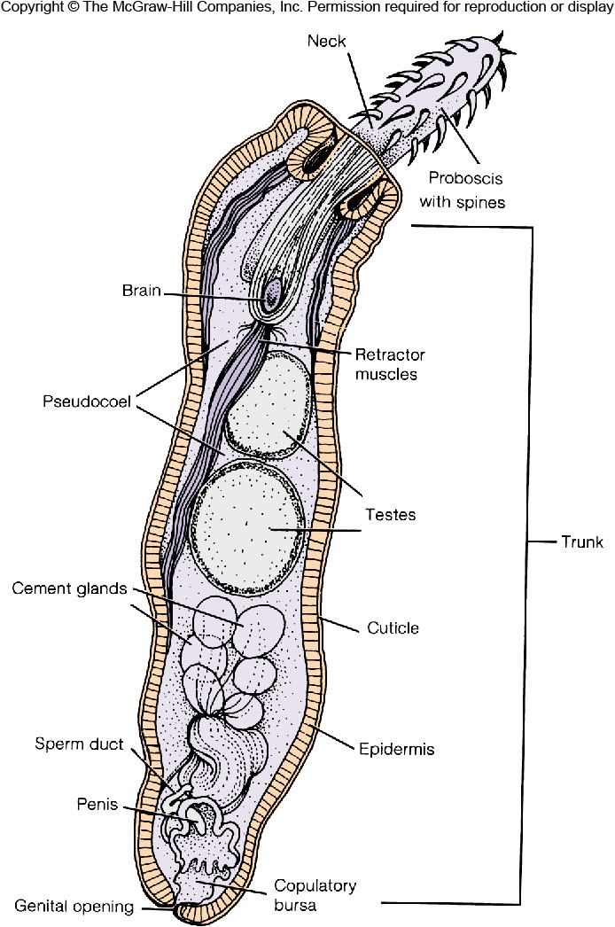
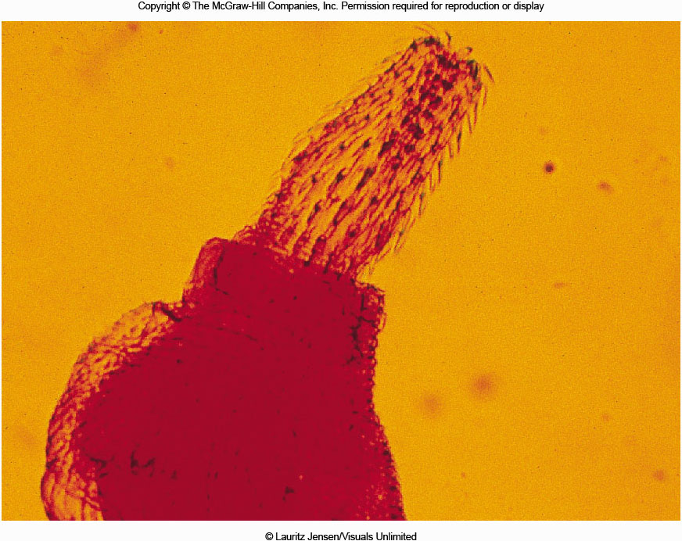
9.3 Phylum Acanthocephala 棘头

Slide 19
Phylum Acanthocephala
About 1000 species
1-65 cm, mostly 25 cm
Proboscis吻部covered with spines: attachment in the host’s intestine
Endoparasite
Juvenile: crustaceans or insects
Adult: intestinal tract of vertebrates
No digestive system present, absorb food through the epidermis from the host

Slide 20
OUTLINE
9.1 General Characteristics
9.2 Phylum Rotifera 轮虫
9.3 Phylum Acanthocephala 棘头
9.4 Phylum Nematoda 线虫
9.5 Phylum Nematomorpha 线形
9.6 Phylum Kinorhyncha 动吻
9.7 Phylum Loricifera 铠甲
9.8 Phylum Priapulida 鳃曳
9.9 Phylum Enoprocta 内肛
Lopho-
trochozoa
Ecdysozoa

Slide 21
Phylum Nematoda 线虫动物门
Second largest animal phylum after Arthopoda, 16000 to 500000 species, some of the most abundant animals on earth;
Microscopic to several meters;
Body round in cross section, covered by several layers of elastic弹性的 cuticle;
Most with unique excretory system comprised of one or two renette小肾 cells or a set of collecting tubules;
Parasites of plants, animals; free-living in marine, freshwater, or soil.

Slide 22
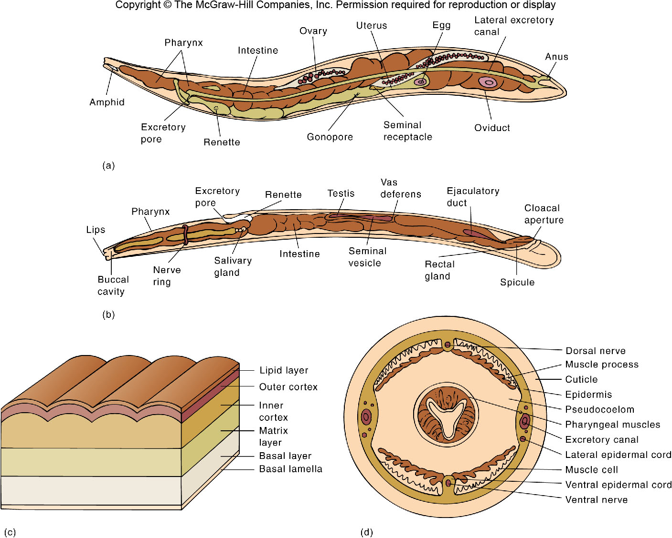
Female
头感器
输精管
射精管
Male
Cuticle
Cross section (body wall has only
longitudinal muscles)
Internal anatomical features of nematodes

Slide 23
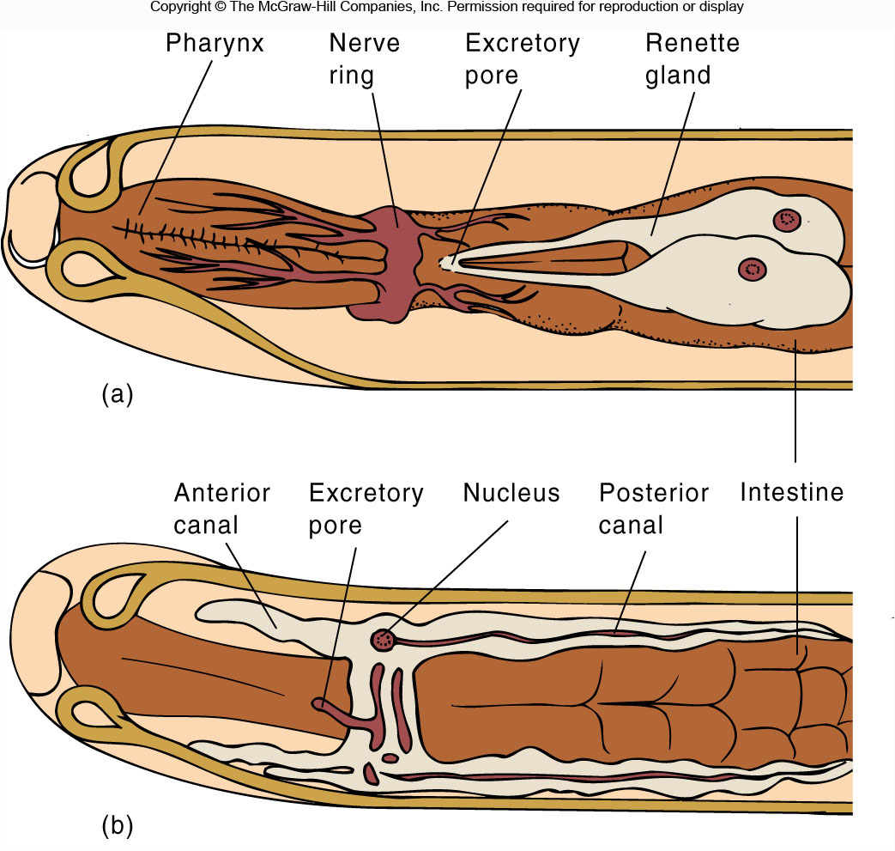
Nematode excretory system

Slide 24
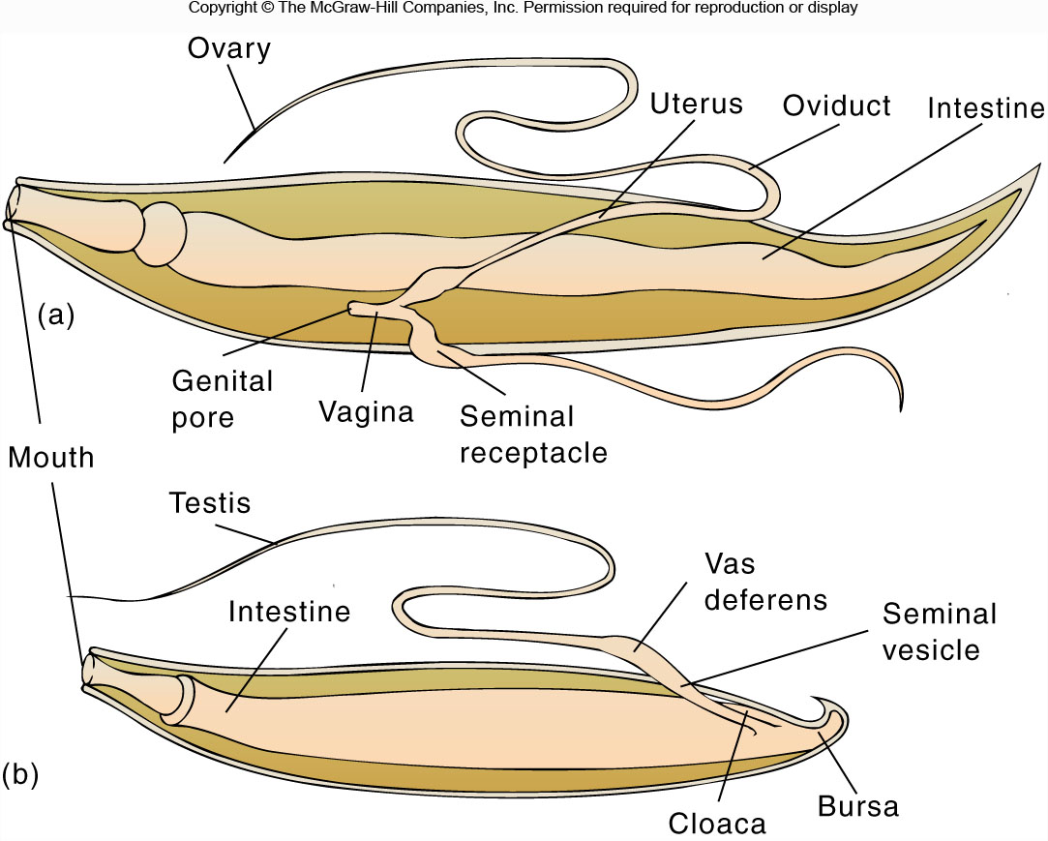
输精管
交尾刺
泄殖腔
Nematode reproductive systems

Slide 25
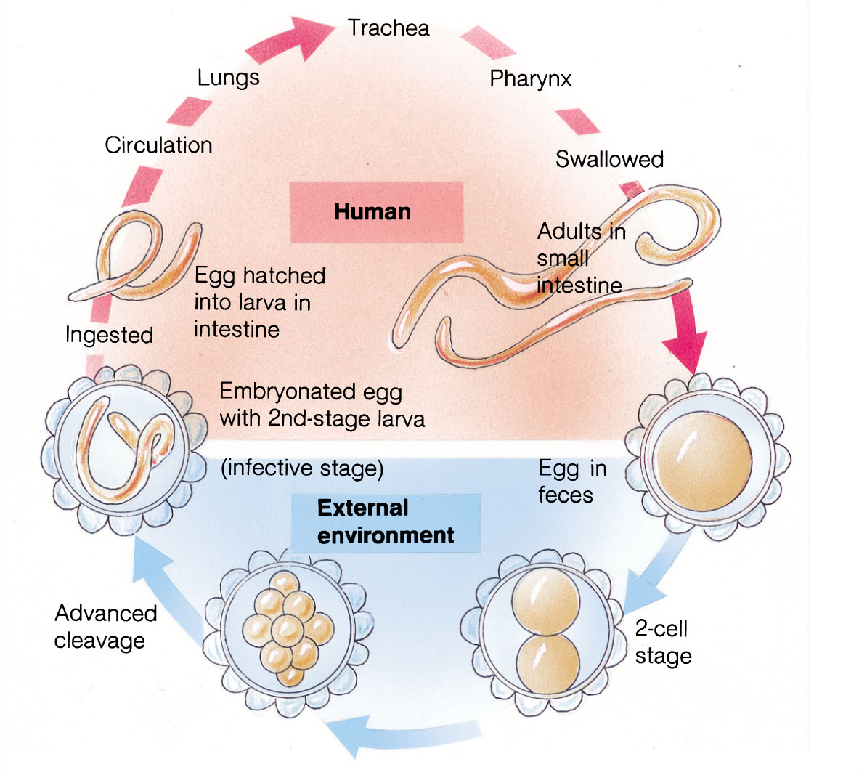

Important nematode parasites of humans
气管
Roundworm
A.Lumbricoides
蛔虫

Slide 26
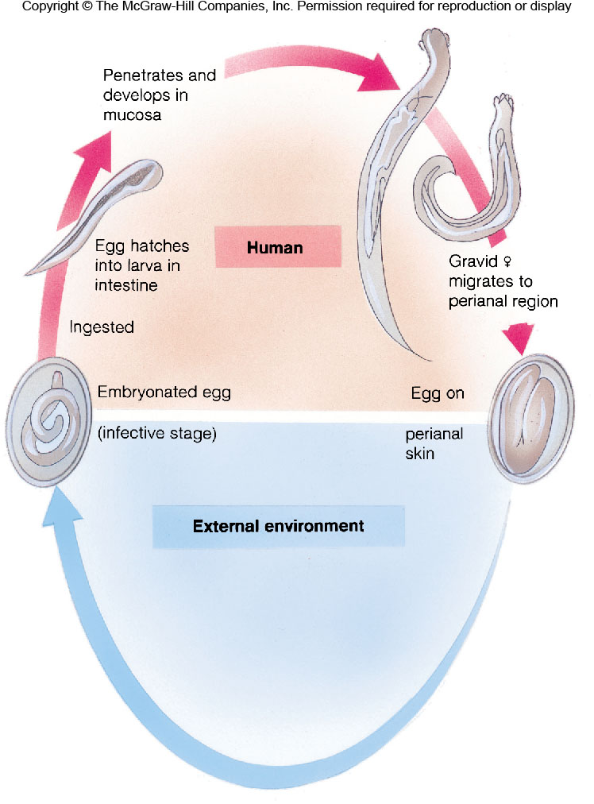
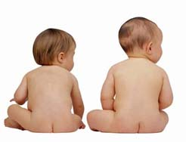
Enterobius vermicularis
蛲虫病

Slide 27
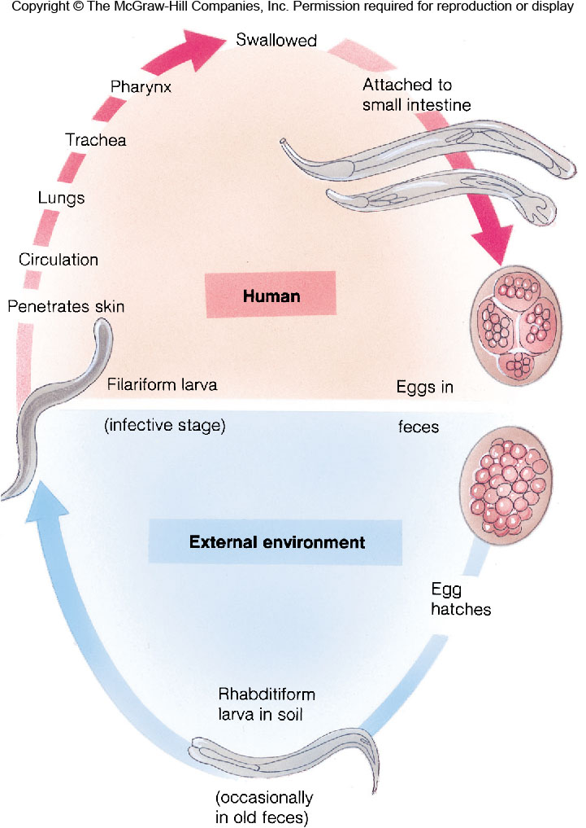
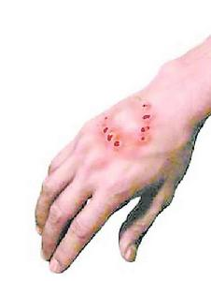
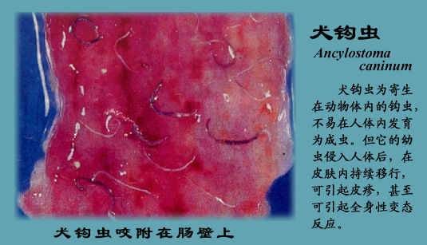
Necator americanus
美洲钩虫

Slide 28
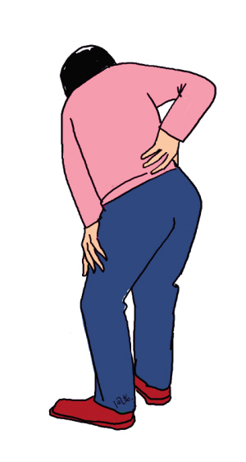
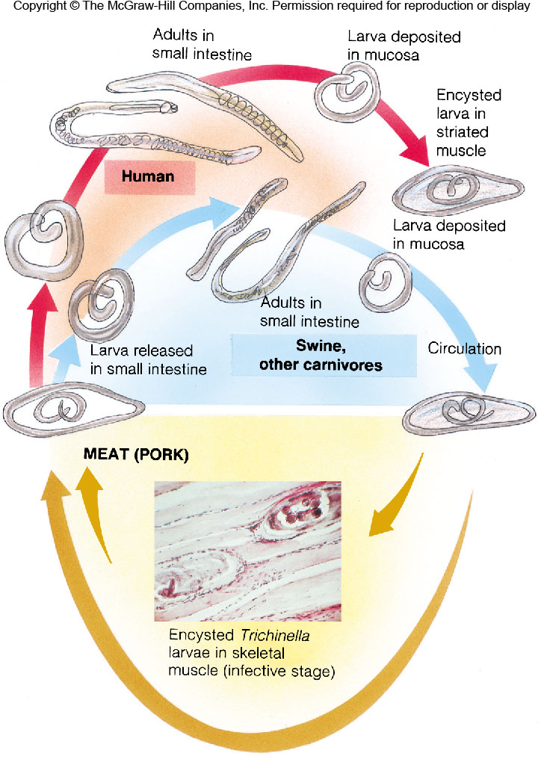
Trichinella spiralis
旋毛线虫

Slide 29
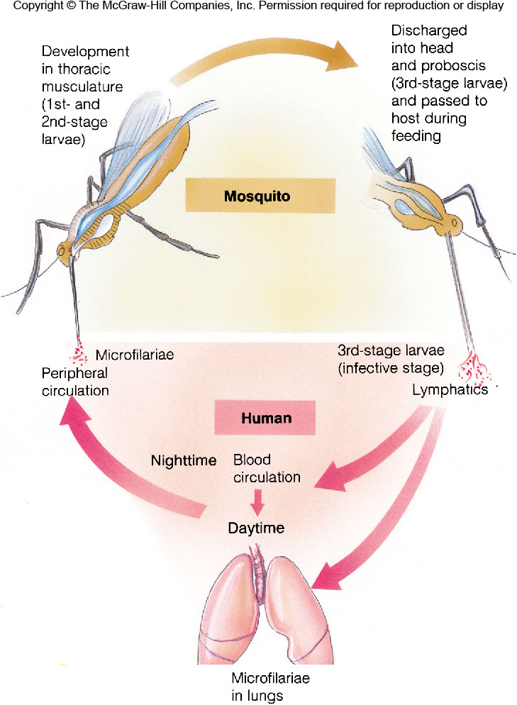
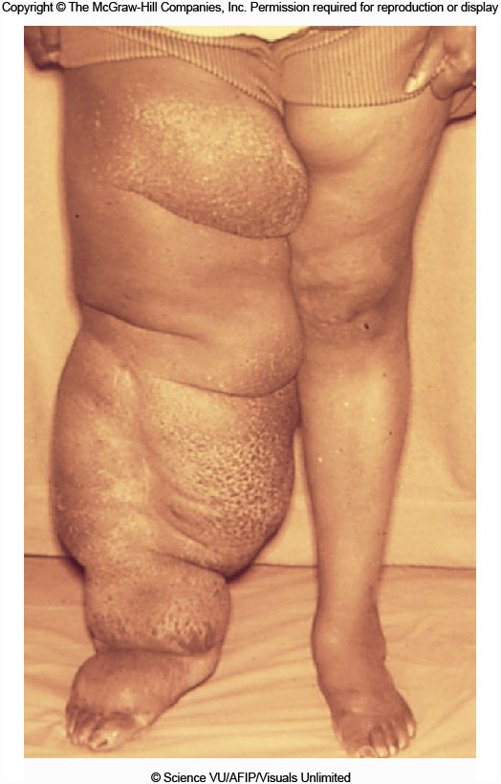
Wuchereria spp.
丝虫

Slide 30
OUTLINE
9.1 General Characteristics
9.2 Phylum Rotifera 轮虫
9.3 Phylum Acanthocephala 棘头
9.4 Phylum Nematoda 线虫
9.5 Phylum Nematomorpha 线形
9.6 Phylum Kinorhyncha 动吻
9.7 Phylum Loricifera 铠甲
9.8 Phylum Priapulida 鳃曳
9.9 Phylum Enoprocta 内肛
Lopho-
trochozoa
Ecdysozoa

Slide 31
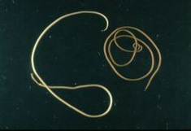
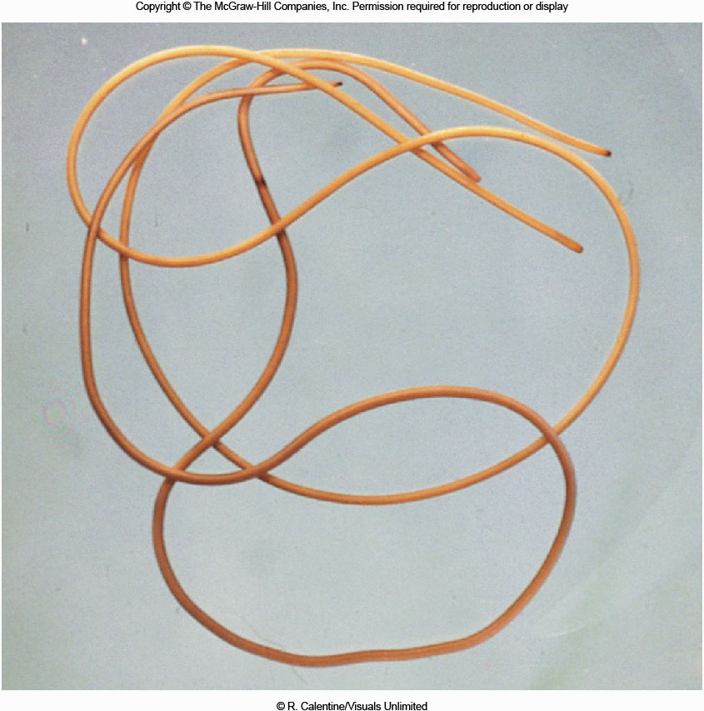
Phylum Nematomorpha 线形动物门
• ~ 250 species
• Hairlike body, 30-150 cm
• Juvenile parasitic in arthropods, adult free-living
Gordius worms

Slide 32
OUTLINE
9.1 General Characteristics
9.2 Phylum Rotifera 轮虫
9.3 Phylum Acanthocephala 棘头
9.4 Phylum Nematoda 线虫
9.5 Phylum Nematomorpha 线形
9.6 Phylum Kinorhyncha 动吻
9.7 Phylum Loricifera 铠甲
9.8 Phylum Priapulida 鳃曳
9.9 Phylum Enoprocta 内肛
Lopho-
trochozoa
Ecdysozoa

Slide 33
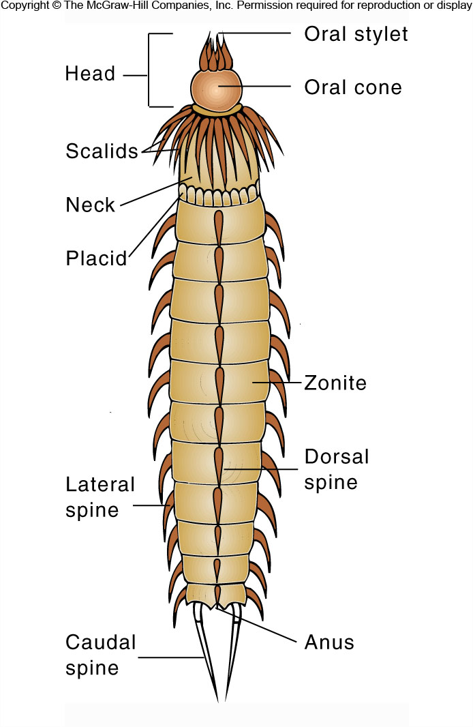
口针
Phylum Kinorhyncha
动吻动物门
口锥
鳞片
~150 species;
Less than 1 mm;
Body is composed of
13-14 definite units;
All marine, burrowing
in mud and sand, with
high abundance.
带节
尾刺

Slide 34
OUTLINE
9.1 General Characteristics
9.2 Phylum Rotifera 轮虫
9.3 Phylum Acanthocephala 棘头
9.4 Phylum Nematoda 线虫
9.5 Phylum Nematomorpha 线形
9.6 Phylum Kinorhyncha 动吻
9.7 Phylum Loricifera 铠甲
9.8 Phylum Priapulida 鳃曳
9.9 Phylum Enoprocta 内肛
Lopho-
trochozoa
Ecdysozoa

Slide 35
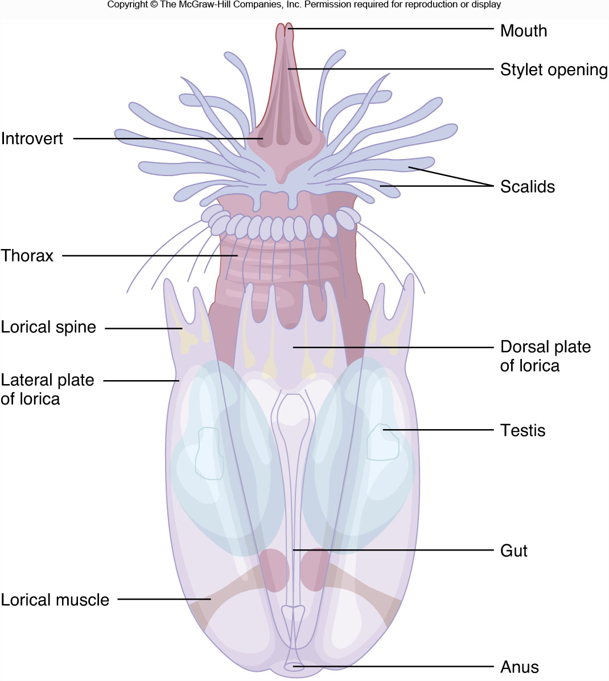
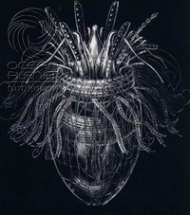
Phylum Loricifera 铠甲动物门
• only 14 species, < 0.25 mm, all marine
刺针开口
铠甲

Slide 36
OUTLINE
9.1 General Characteristics
9.2 Phylum Rotifera 轮虫
9.3 Phylum Acanthocephala 棘头
9.4 Phylum Nematoda 线虫
9.5 Phylum Nematomorpha 线形
9.6 Phylum Kinorhyncha 动吻
9.7 Phylum Loricifera 铠甲
9.8 Phylum Priapulida 鳃曳
9.9 Phylum Enoprocta 内肛
Lopho-
trochozoa
Ecdysozoa

Slide 37
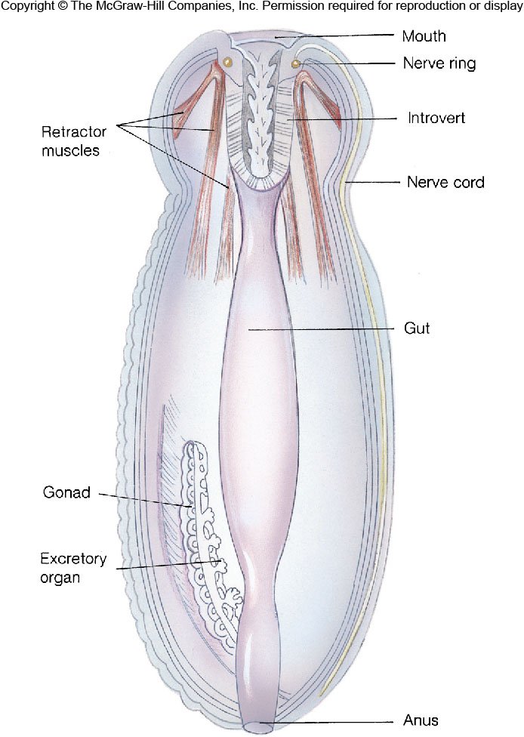
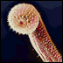
Phylum Priapulida 鳃曳动物门
Only 16 species
2 mm - 8 cm long
Marine

Slide 38
OUTLINE
9.1 General Characteristics
9.2 Phylum Rotifera 轮虫
9.3 Phylum Acanthocephala 棘头
9.4 Phylum Nematoda 线虫
9.5 Phylum Nematomorpha 线形
9.6 Phylum Kinorhyncha 动吻
9.7 Phylum Loricifera 铠甲
9.8 Phylum Priapulida 鳃曳
9.9 Phylum Enoprocta 内肛
Lopho-
trochozoa
Ecdysozoa

Slide 39
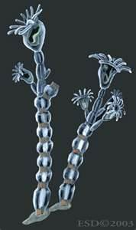
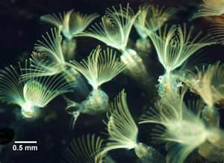
Phylum Entoprocta 内肛动物门
Anus outside
of the
lophophore,
with true
coelom.
Anus inside
of the
lophophore,
with pseudo-
coelom.
Ectoprocta
外肛动物门
苔藓动物
Entoprocta
Bryozoa
(moss animals)

Slide 40


